Slide 1
Valid Arguments

Slide 2
Revisit:

Slide 3
Example:
“If I am sick, there will be no lecture today;”
“either there will be a lecture today, or all the students will be happy;”
“the students are not happy.”

Slide 5
If I am sick, there will be no lecture today;
Either there will be a lecture today, or all the students will be happy;
The students are not happy.
So, I am not sick
Translate into logic as: s→¬l, l ∨ h, ¬h
Then we can reach a conclusion as follows:
l∨h [hypothesis]
¬h [hypothesis]
L [disjunctive syllogism using (1) and (2)]
s→¬l [hypothesis]
¬s [modus tollens using (3) and (4)]
So, I am not sick

Slide 6
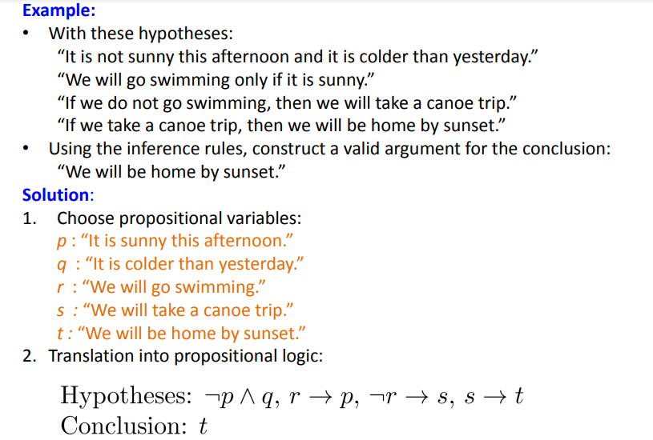

Slide 7
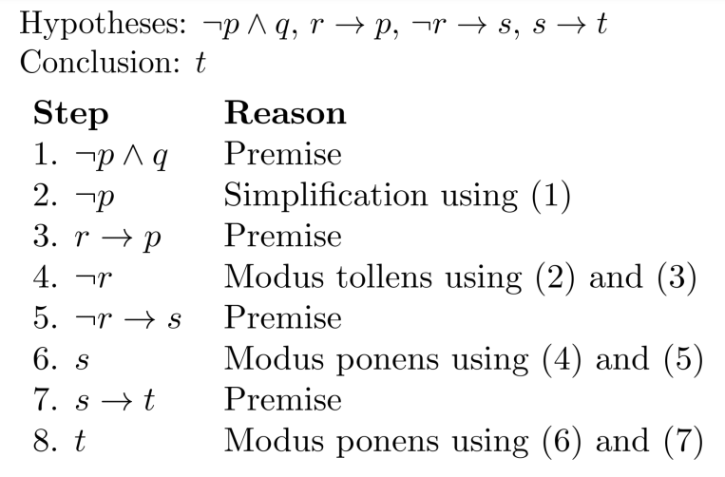

Slide 8
Validity and Satisfiability of W.F.F
Validity means formula is true for all possible assignment of the truth values of variables.
Satisfiability refers to the existence of a combination of values to make the expression true.
So in short, a proposition is satisfiable if there is at least one true result in its truth table, valid if all values it returns in the truth table are true

Slide 9
Satifiablity problem (SAT Problem)
problem of determining if there exists an interpretation that satisfies a given Propositional/Boolean formula
In other words, it asks whether the variables of a given Propositional/Boolean formula can be consistently replaced by the values TRUE or FALSE in such a way that the formula evaluates to TRUE
For example, the formula "a AND NOT b" is satisfiable because one can find the values a = TRUE and b = FALSE, which make (a AND NOT b) = TRUE. In contrast, "a AND NOT a" is unsatisfiable.
It is a hard problem
If a formula have 3 variables it is called 3SAT Problem.

Slide 10
Example

